Slide 1

Interactive plotting with R
Annie Yu, Epidemiological Programmer
Hertfordshire County Council

Slide 2
Learning objectives
What are interactive plots/graphs?
When it’s appropriate to use interactive visualisations over static and vice versa
Basic uses of plotly and echarts4r packages
How to refer to JS documentation to add extra functionality to your plots
How to present your interactive plots in Rmarkdown documents or Shiny apps

Slide 3
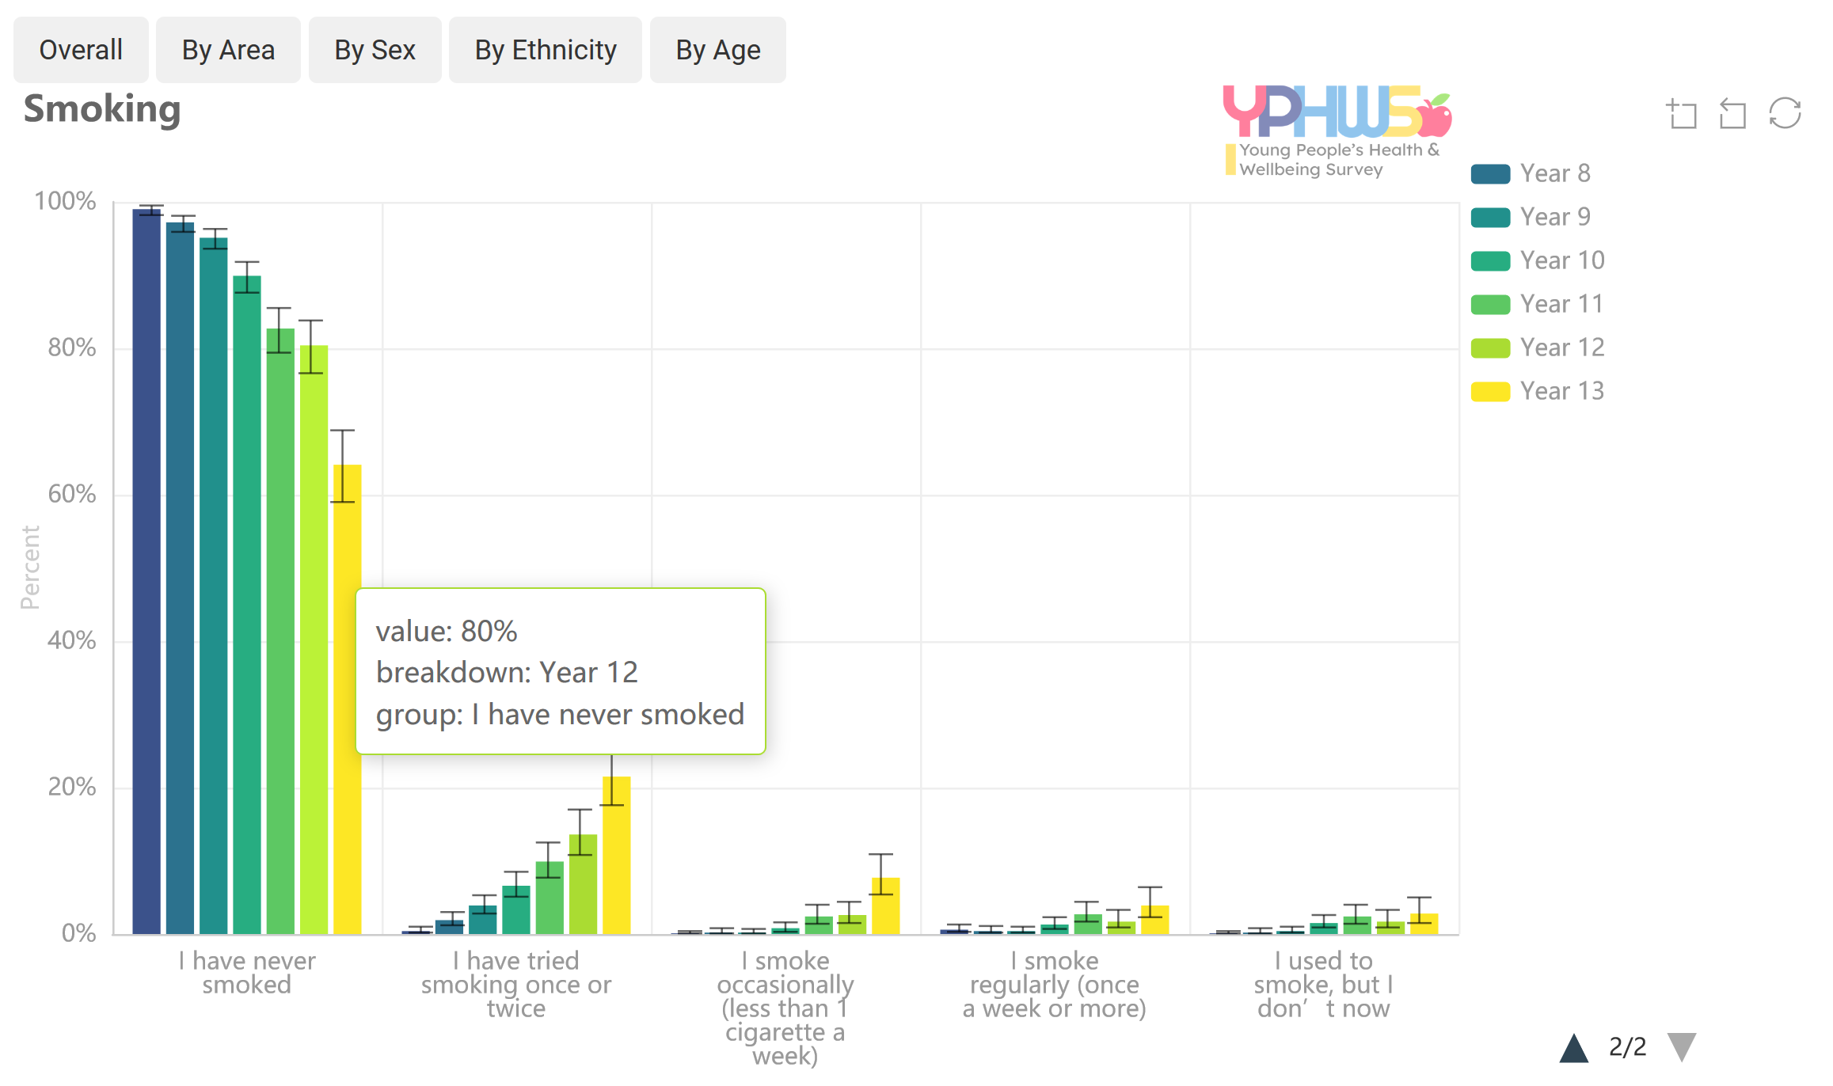
What are interactive plots?
Modebar buttons for zooming in the plot and more
An interactive charts allows the user to perform actions: zooming, hovering over a marker to get values, choosing a variable to display and more.
Interactive plot libraries include “plotly”, “highcharts”, “echarts4r”, “leaflet” for mapping, “networkD3” for network graphs, and more.
Clickable legend for manual selection/deselection
Tooltip appears on hover

Slide 4
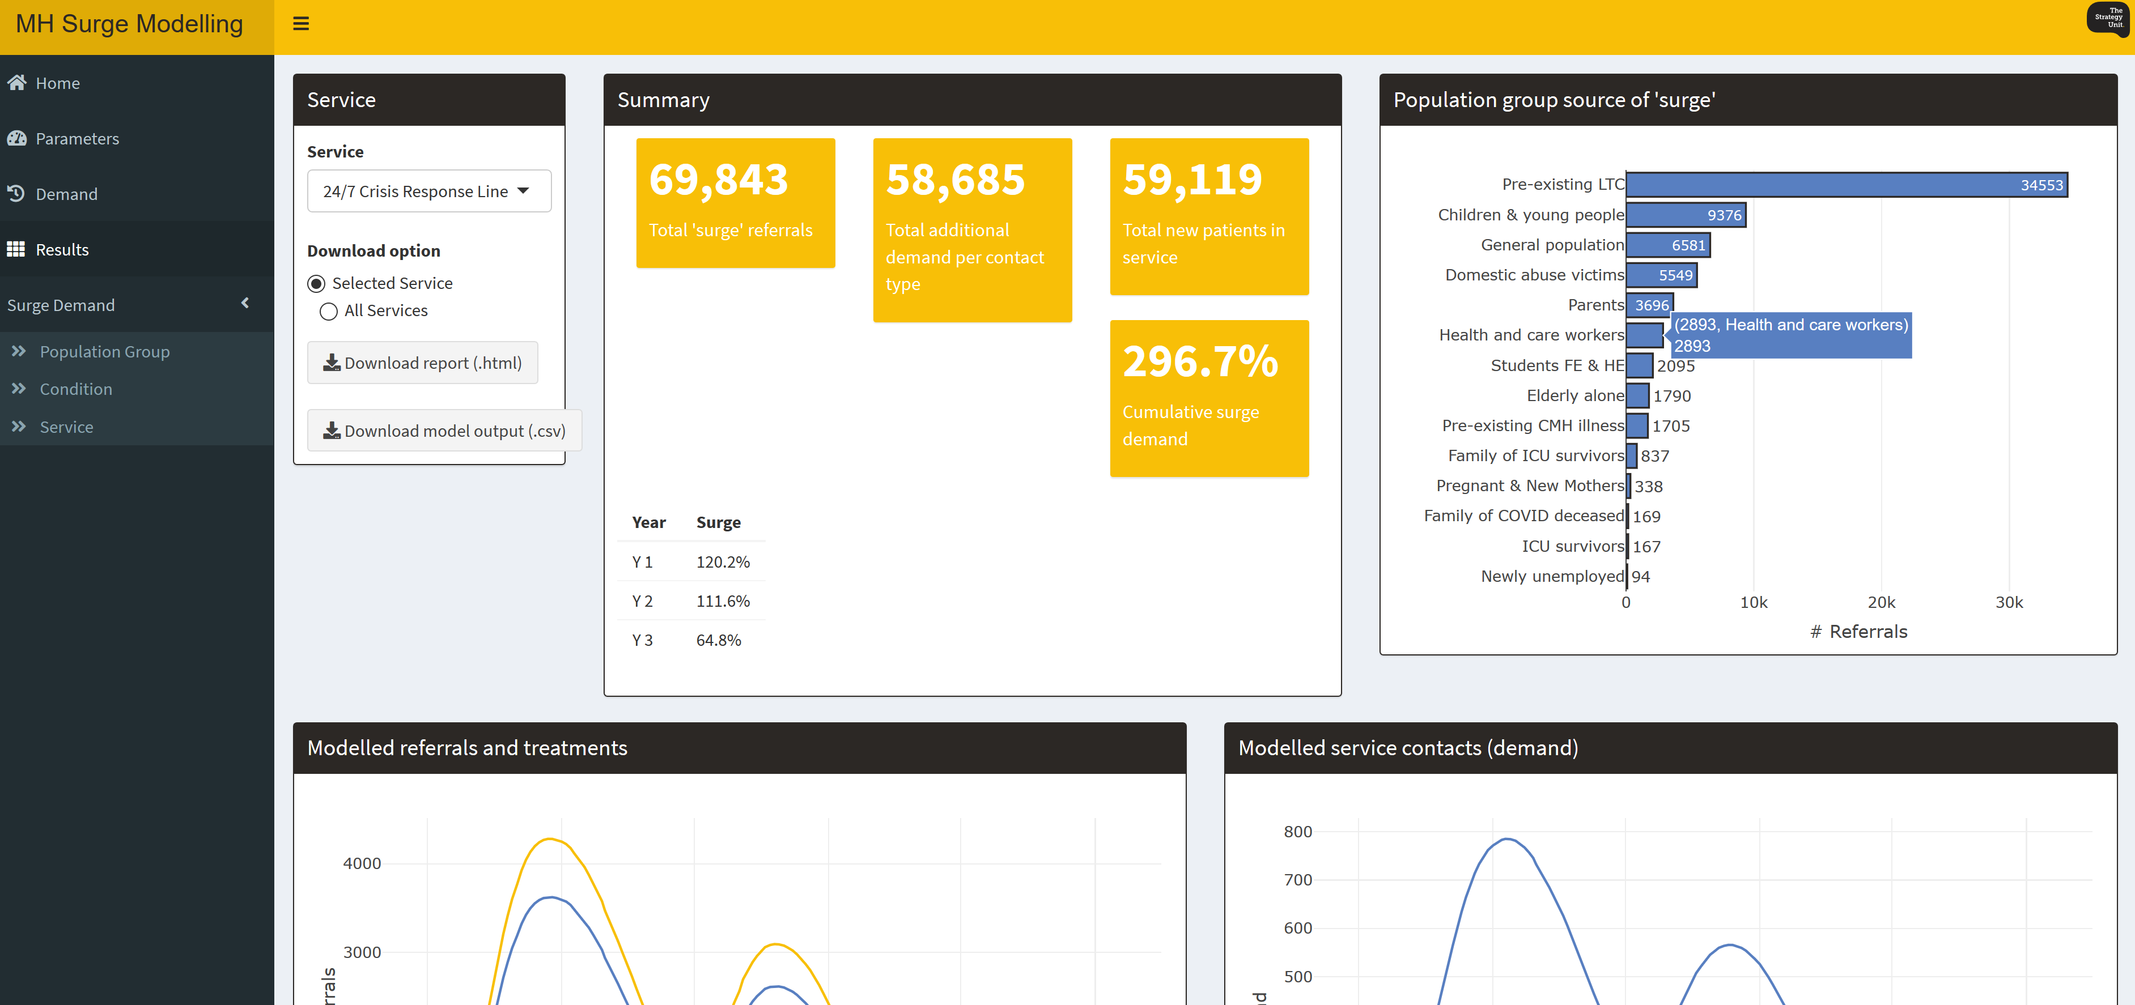
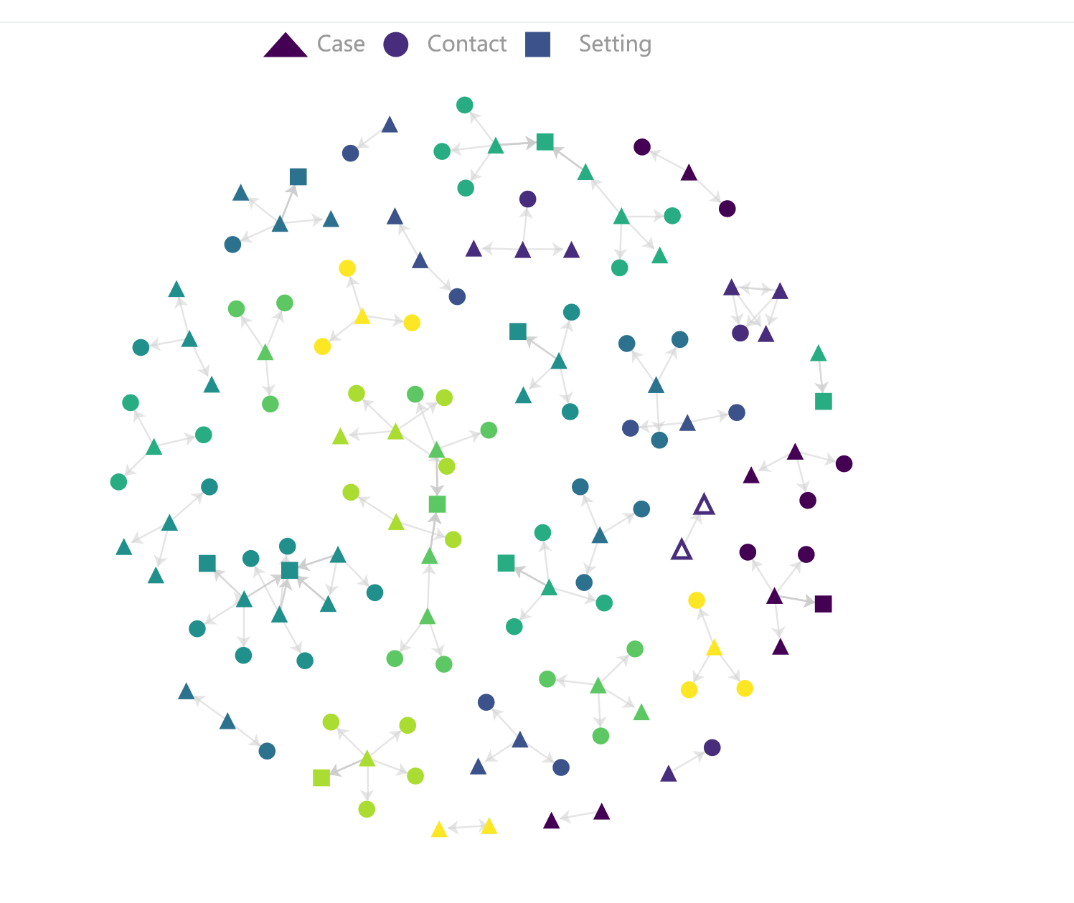
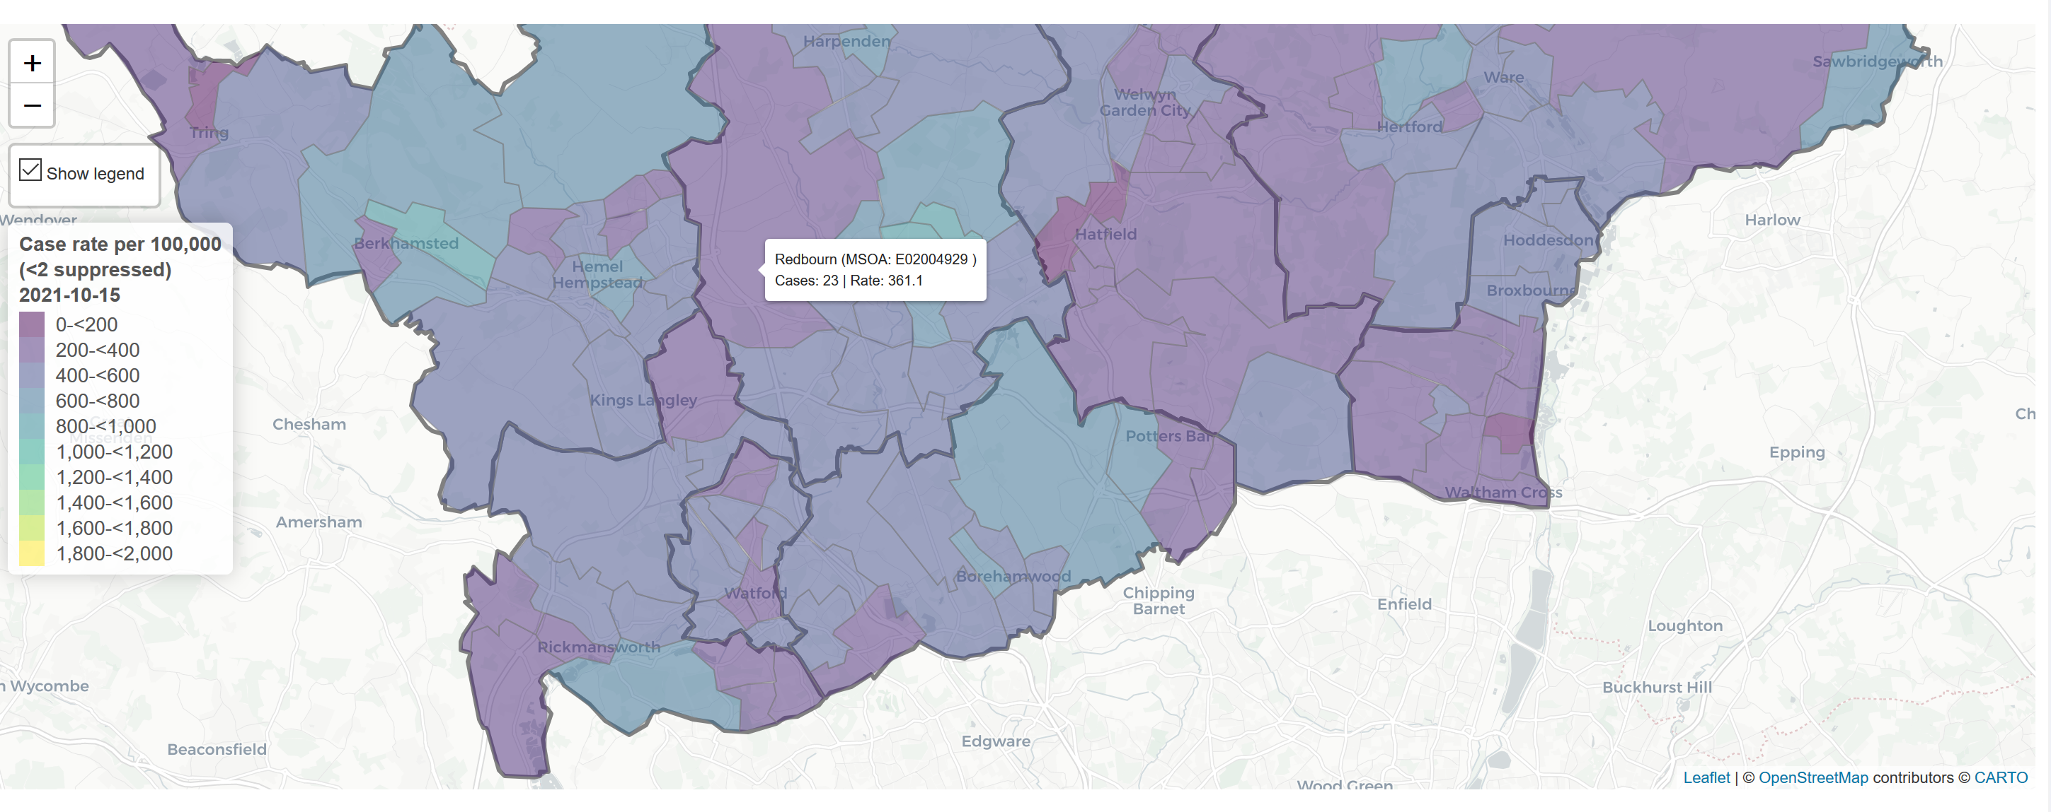
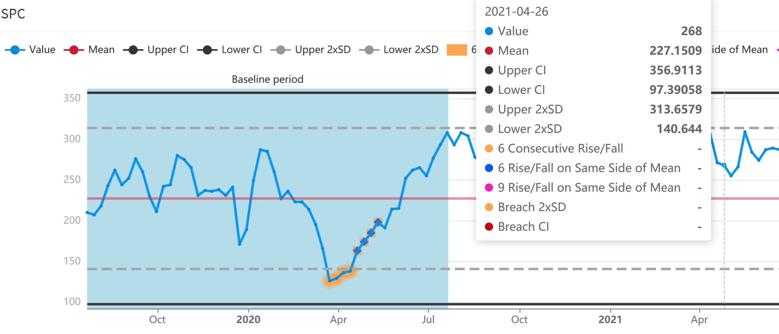
You will typically find interactive plots in Rmarkdown documents, dashboards, and shiny apps!

Slide 5
When to use interactive plots
Static plots made using ggplot2 are easily customisable and can be used for most occasions. However, if you want any of the following, you may want to consider creating an interactive plot:
If your plot has many data points/bars and you want the user to be able to see the exact values on hover
If your plot has a lot of data you want to show and you want the viewer to interact with it for more detail instead of showing it all at once.
If you want the viewer to be able to filter the plot by period or another variable
If you want shared interactivity between several plots.
If you want to engage the viewer more with your graph by zooming in, taking a snapshot, etc.
They look impressive!

Slide 6
When to use interactive plots
However, there are limitations
Interactive plot packages tend to be less customisable compared to ggplot2
Take up more space
Certain functionalities are hard to find in R documentation – many times you will have to refer to original JS documentation!
Certain functionalities (e.g. buttons in plotly) bug easily although there are workarounds
Can confuse the viewer if there is too much functionality

Slide 7

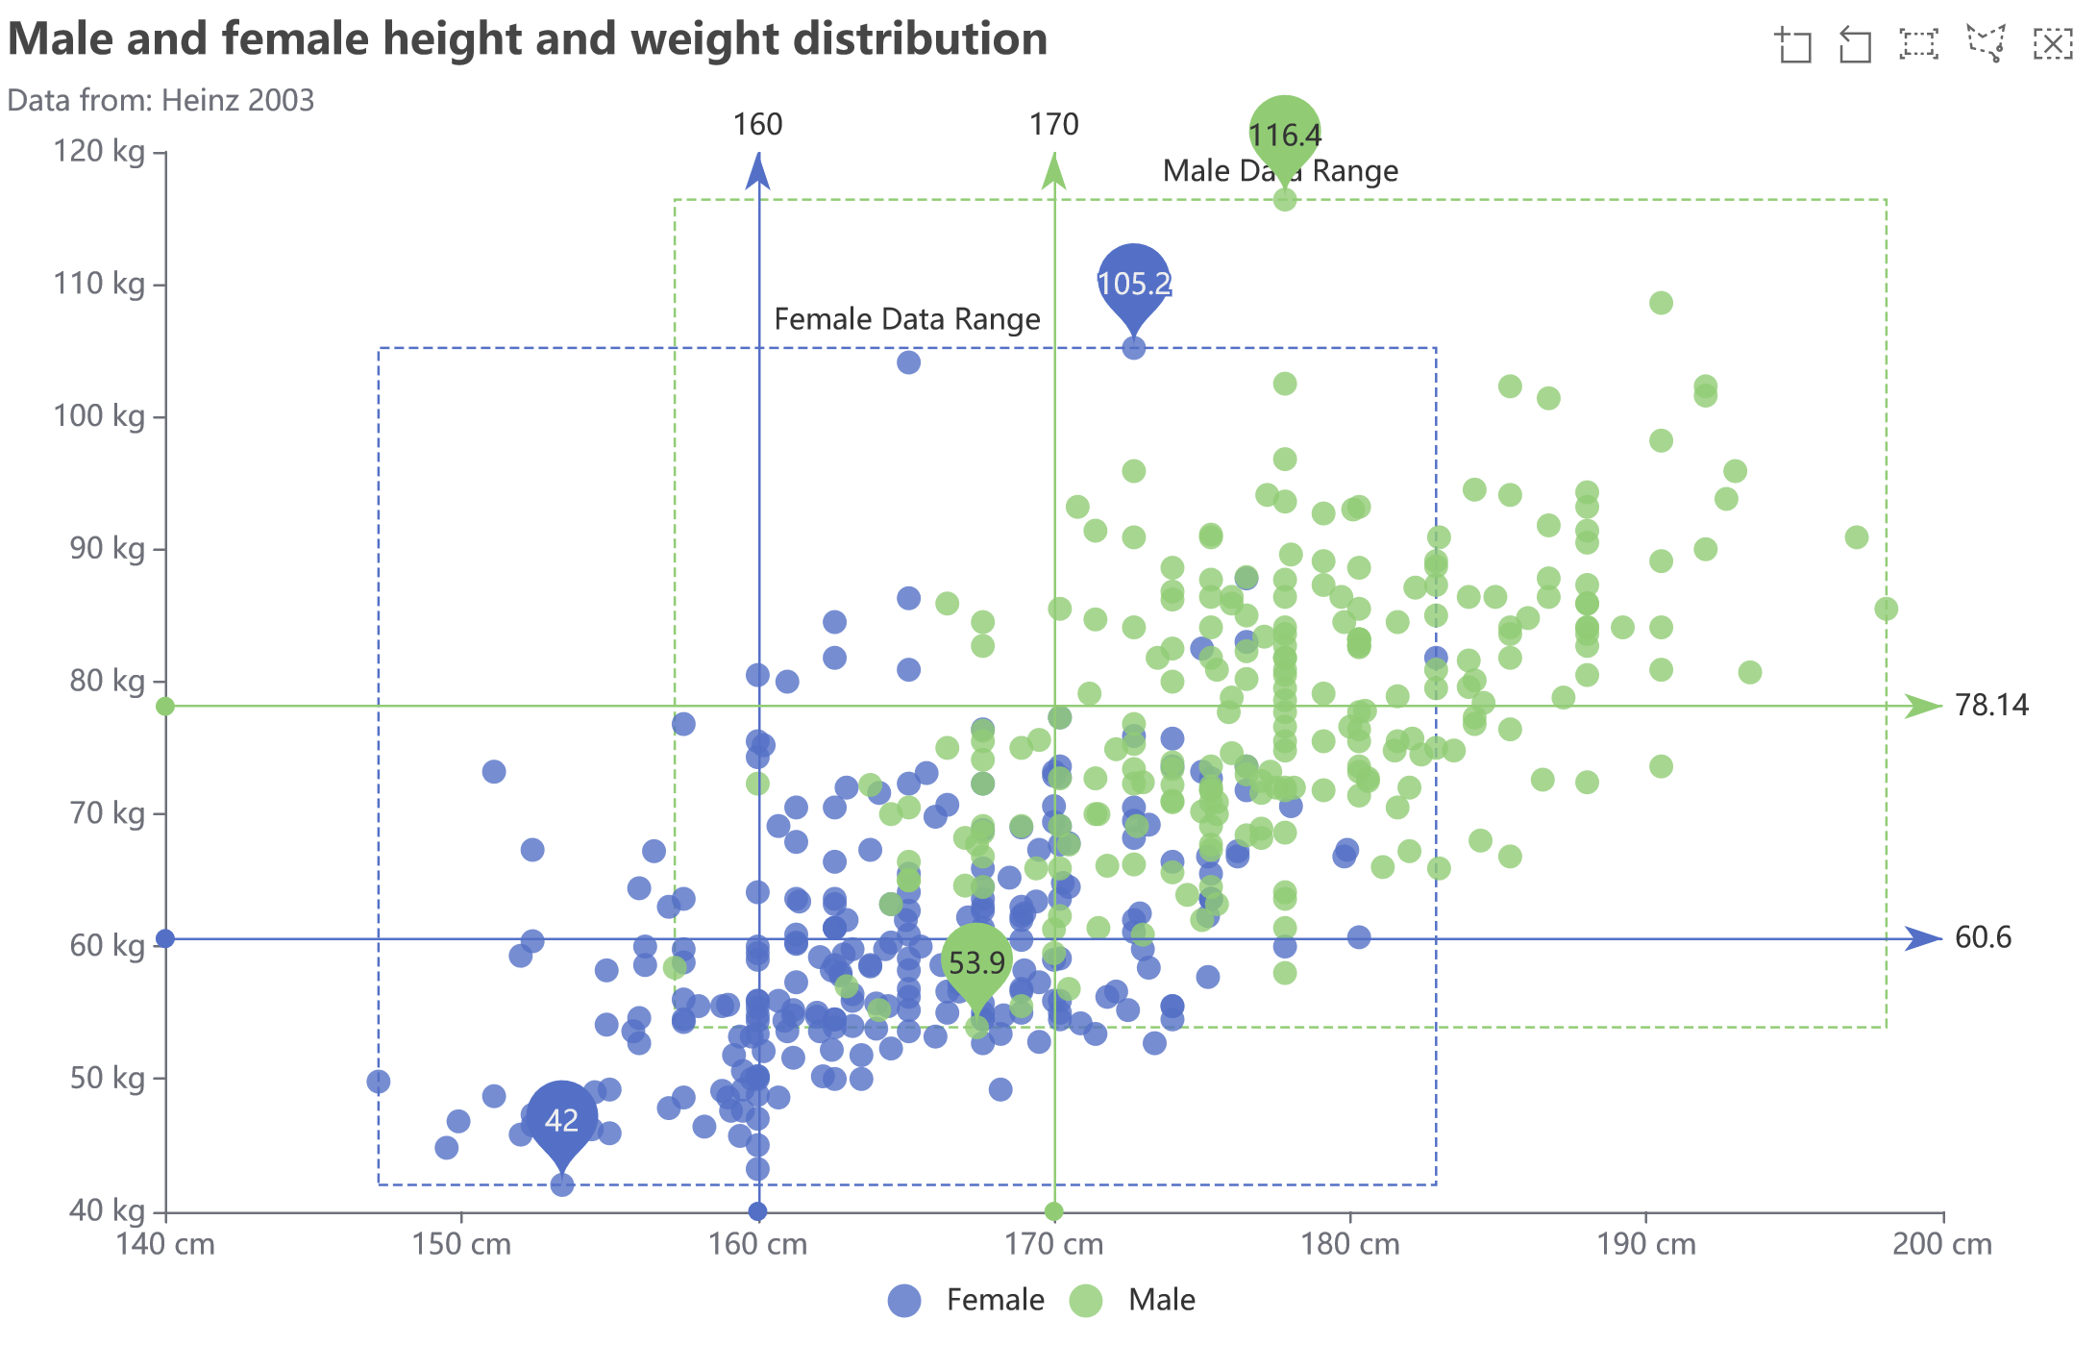
Keep in mind, even though interactive plots can do more than static plot, putting too much functionality into one plot is not good practice! Think about what you are using the interactivity for.

Slide 8

How they work
As you might know, everything is built from JavaScript.
R packages that produce interactive plots are all built on JavaScript. Take for example the most commonly used package – plotly. Graphs produced using the plotly package in R are powered by the JS library plotly.js (likewise, echarts4r is powered by echarts.js) The functions within the package allows you to utilise the JS interface using R code. Because of this, rendering interactive graphs in static documents like .pdfs and .docx won’t work – it will only work if it is opened in a browser like .html documents, server-hosted shiny apps, and in your local RStudio viewer.
If you’ve used JavaScript/done web development before, this might make more sense to you!

Slide 9
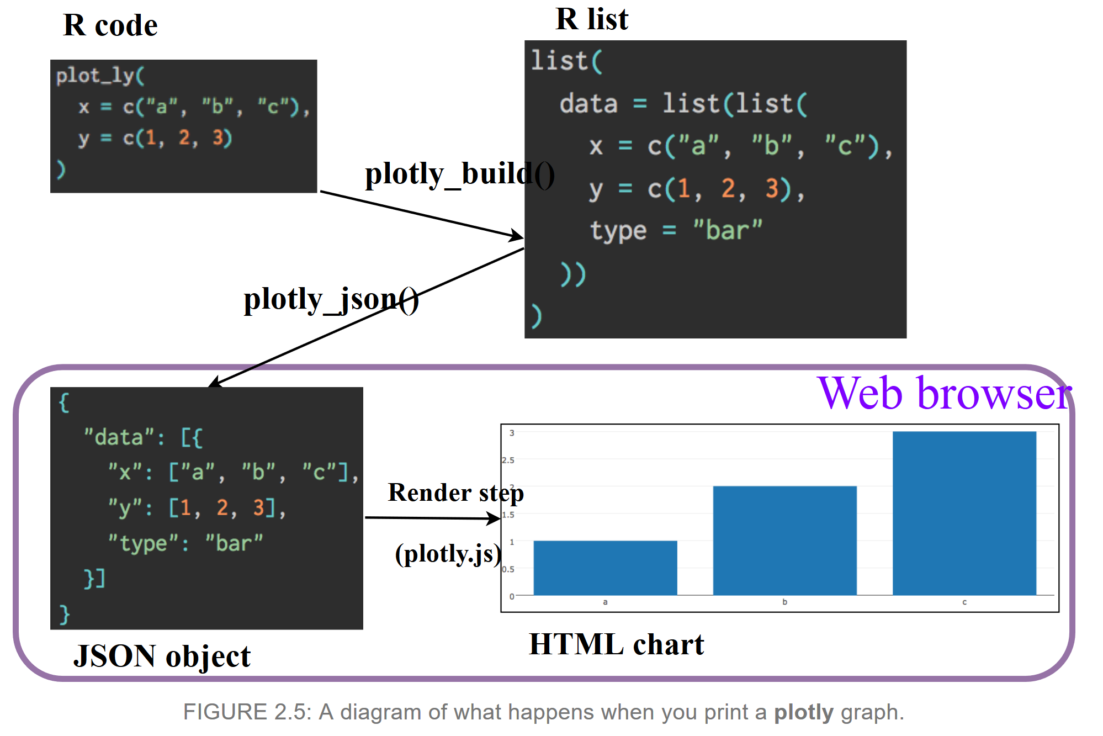
How they work
Source: https://plotly-r.com/overview.html

Slide 10
Training instructions
All the data and scripts you need are in the project folder (either in RStudio Cloud or in this GitHub repo). The first part of this session will focus on plotly and the second will focus on echarts. They each have their own respective folder for you to work in.
coding_sheet_*.R is for you to fill in if you are following along. (recommended)
answer_sheet_*.R contains all the code and answers as a reference
Feel free to use the answer sheet if the session is going too quickly/you missed something!

Slide 11
ggplotly
A quick way to convert a static ggplot2 object into an interactive plotly object
plot <- ggplot(iris, aes(x = Sepal.Length, y = Sepal.Width, color = Species)) + geom_point()
ggplotly(plot)
Good for occasional use – but best to create the plotly object yourself using plotly!

Slide 12

Similar logic to ggplot2.
Basic syntax formula:
plot_ly (data, x=~var, y=~var2, type = “bar”, …) %>%
add_trace(y=~var3, …) %>%
layout(…)
Magrittr pipe works with most interactive packages
data for
base layer
Function call
x and y axis for base layer
Additional args
Adding additional layer (new group based on another variable? Or group based on a variable from another dataset?)
layout() allows you to change the plot layout
(title, axis labels, margins, and more)

Slide 13
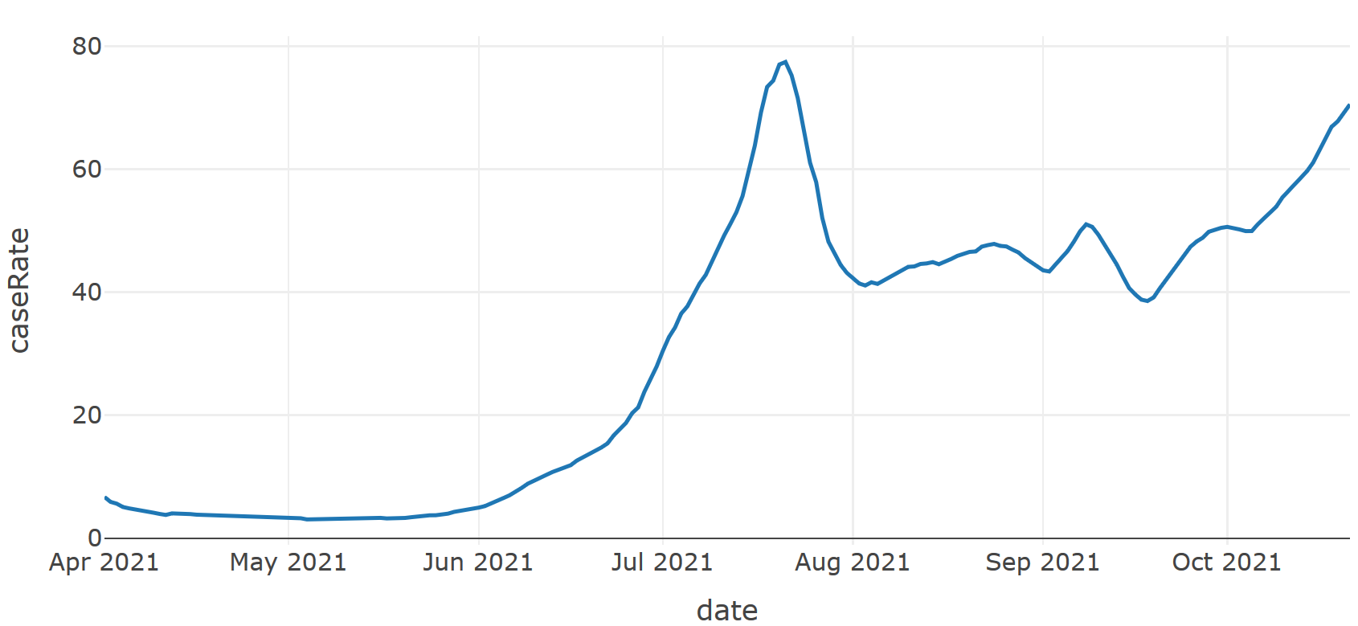
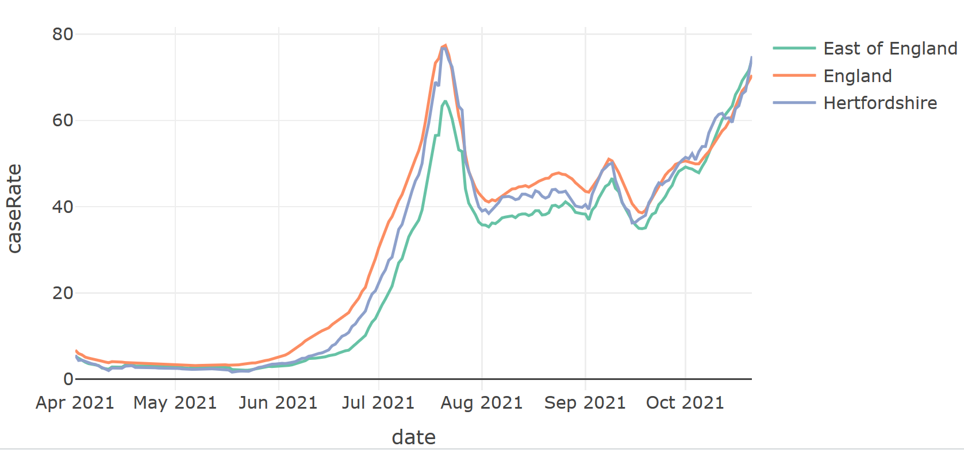
Simple line plot
cases %>%
filter(areaName == "England") %>%
arrange(date) %>%
plot_ly(x = ~date, y = ~caseRate,
type = “scatter”, mode = "lines")
Grouped line plot
cases %>%
arrange(date) %>%
plot_ly(x = ~date, y = ~caseRate, color = ~areaName,
type = “scatter”, mode = "lines")

Slide 14
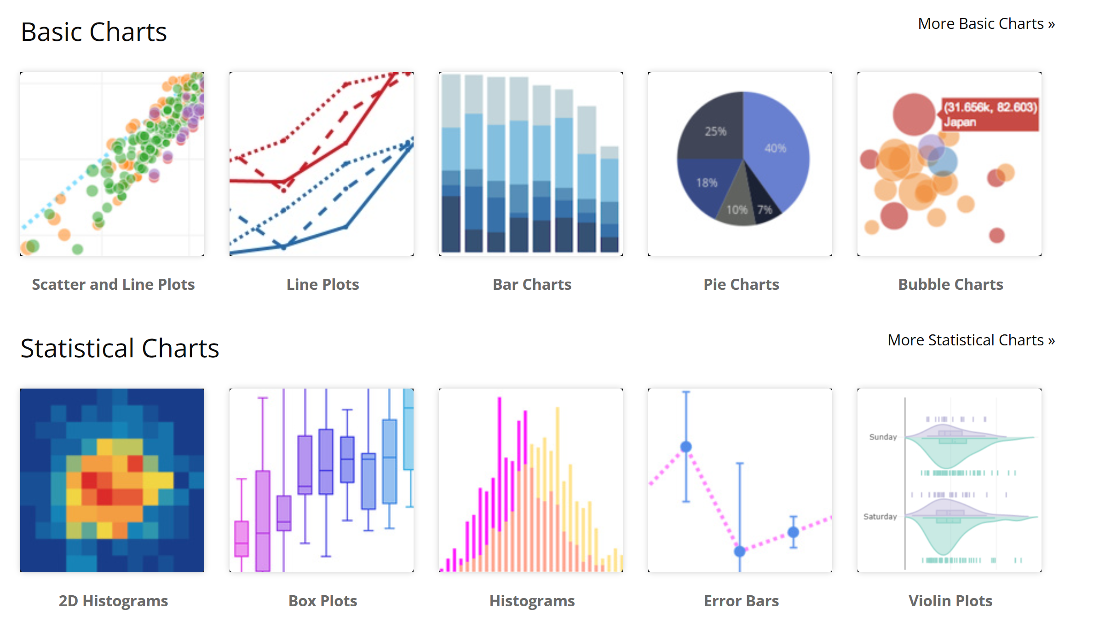
To change the type of plot, use the type argument.
Type = “scatter”
Type = “bar”
Type = “histogram”
Type = “box”
Type = “heatmap”

Slide 15
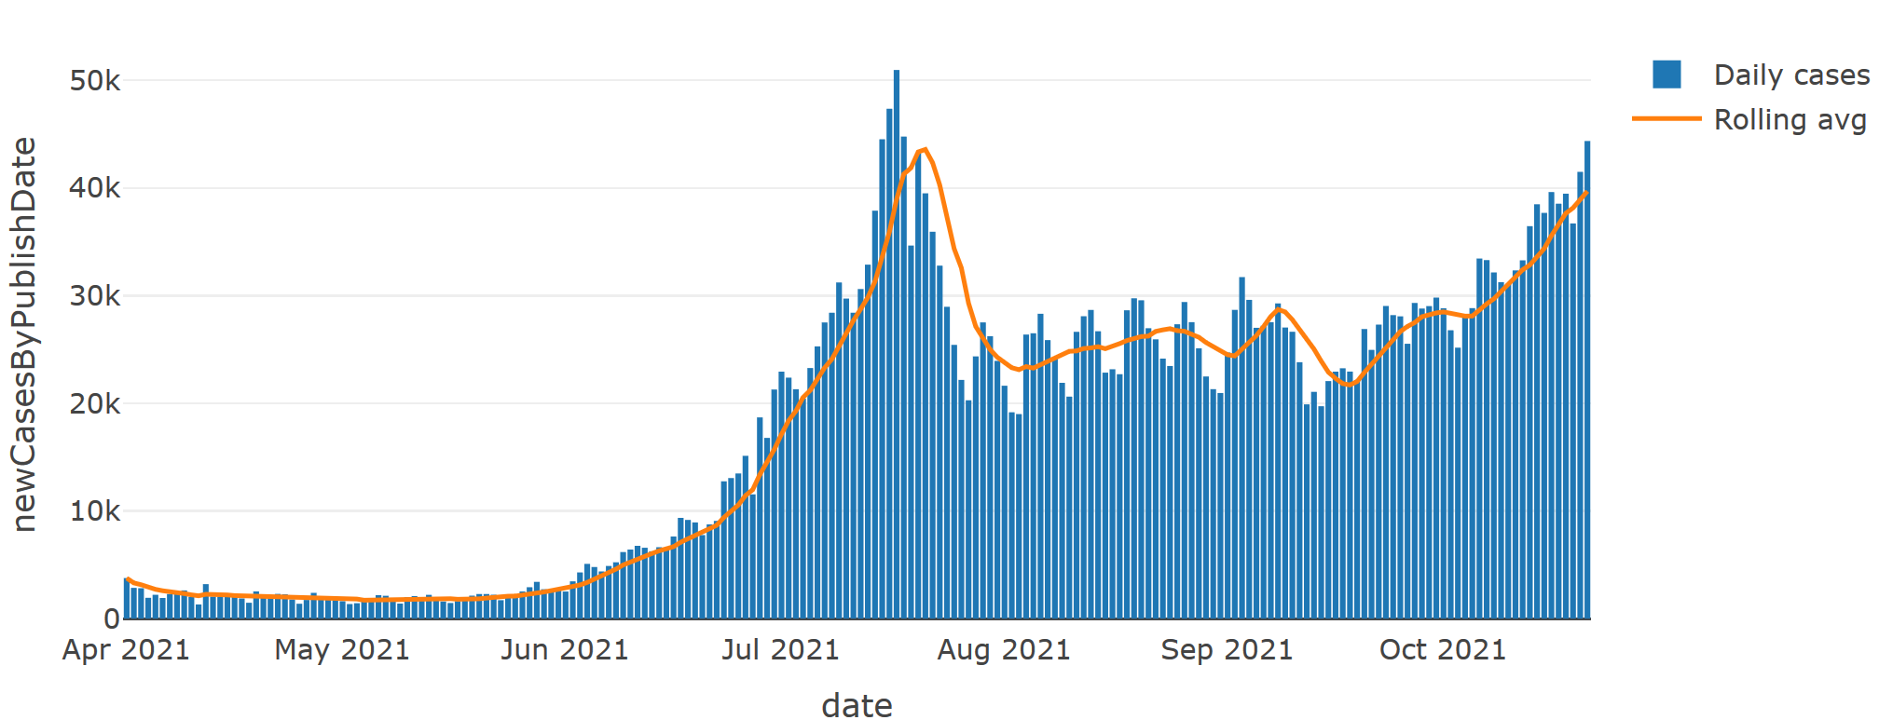
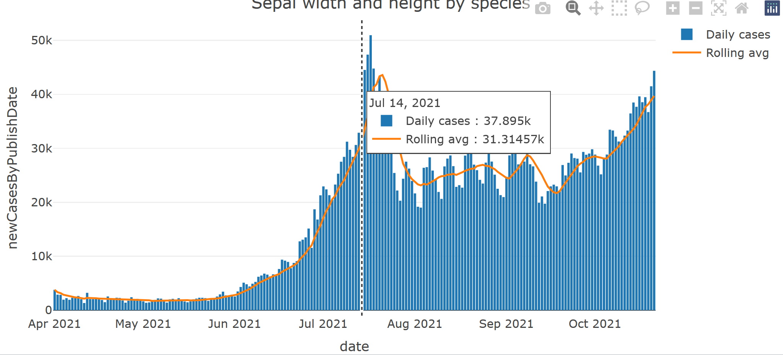
Adding layers (“traces”)
cases %>%
filter(areaName == "England") %>%
arrange(date) %>%
plot_ly(x = ~date, y = ~newCasesByPublishDate,
type = “bar”, name = "Daily cases") %>%
add_trace(y = ~rollingAvg, name = "Rolling avg",
type = “scatter”, mode = “lines”)
Note: add_trace in this case can be replaced with add_lines if you want to be more specific about the type of layer you are adding. If using add_lines, there is no need to specify type or mode.
Editing layout
cases %>%
filter(areaName == "England") %>%
arrange(date) %>%
plot_ly(x = ~date, y = ~newCasesByPublishDate,
type = “bar”, name = "Daily cases") %>%
add_lines(y = ~rollingAvg, name = "Rolling avg") %>%
layout(title = "Positive cases over time",
hovermode = "x unified")

Slide 16
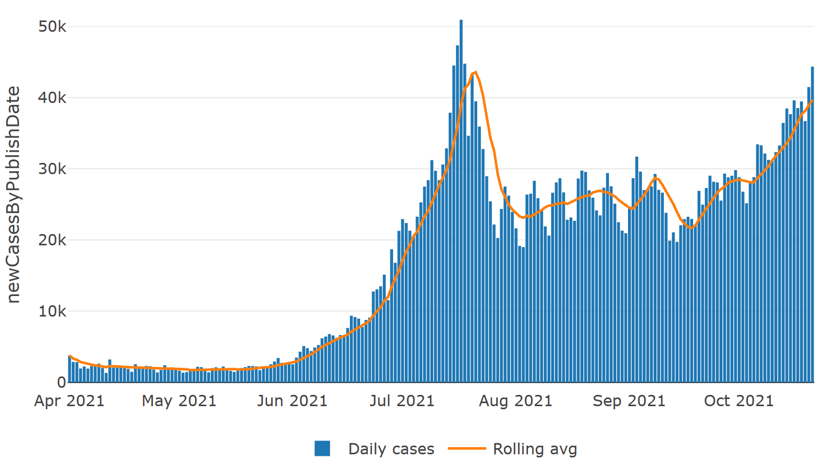
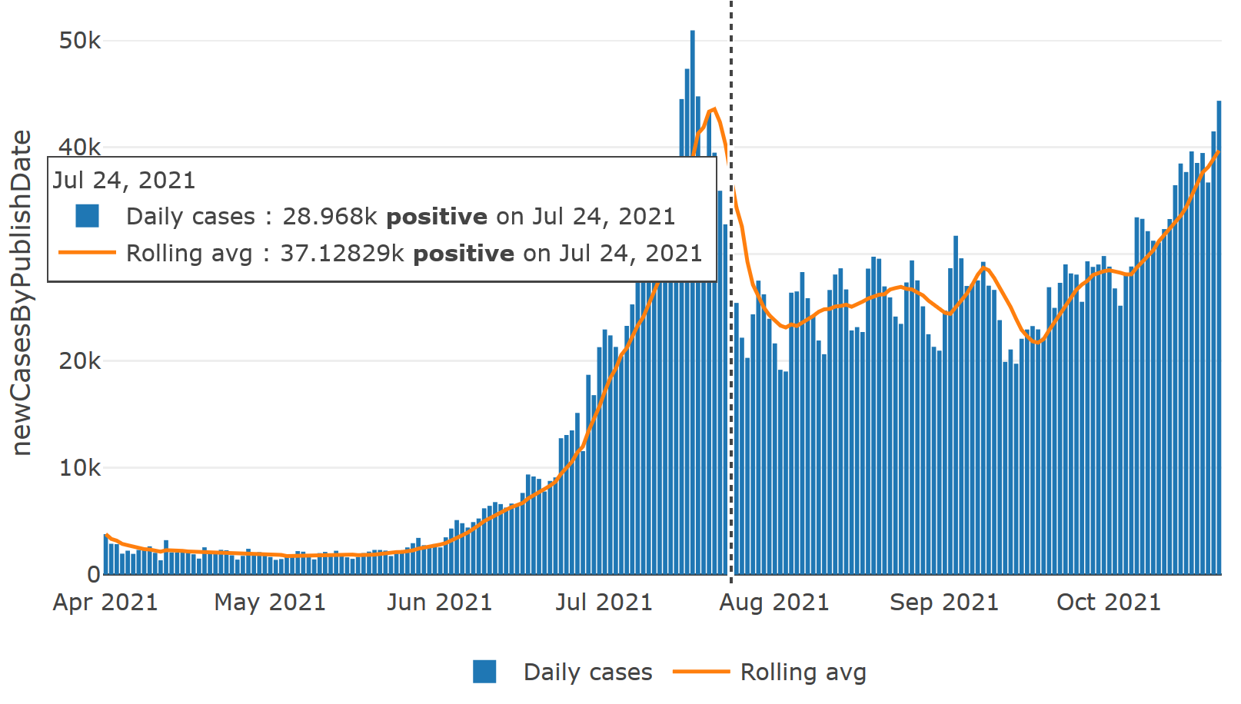
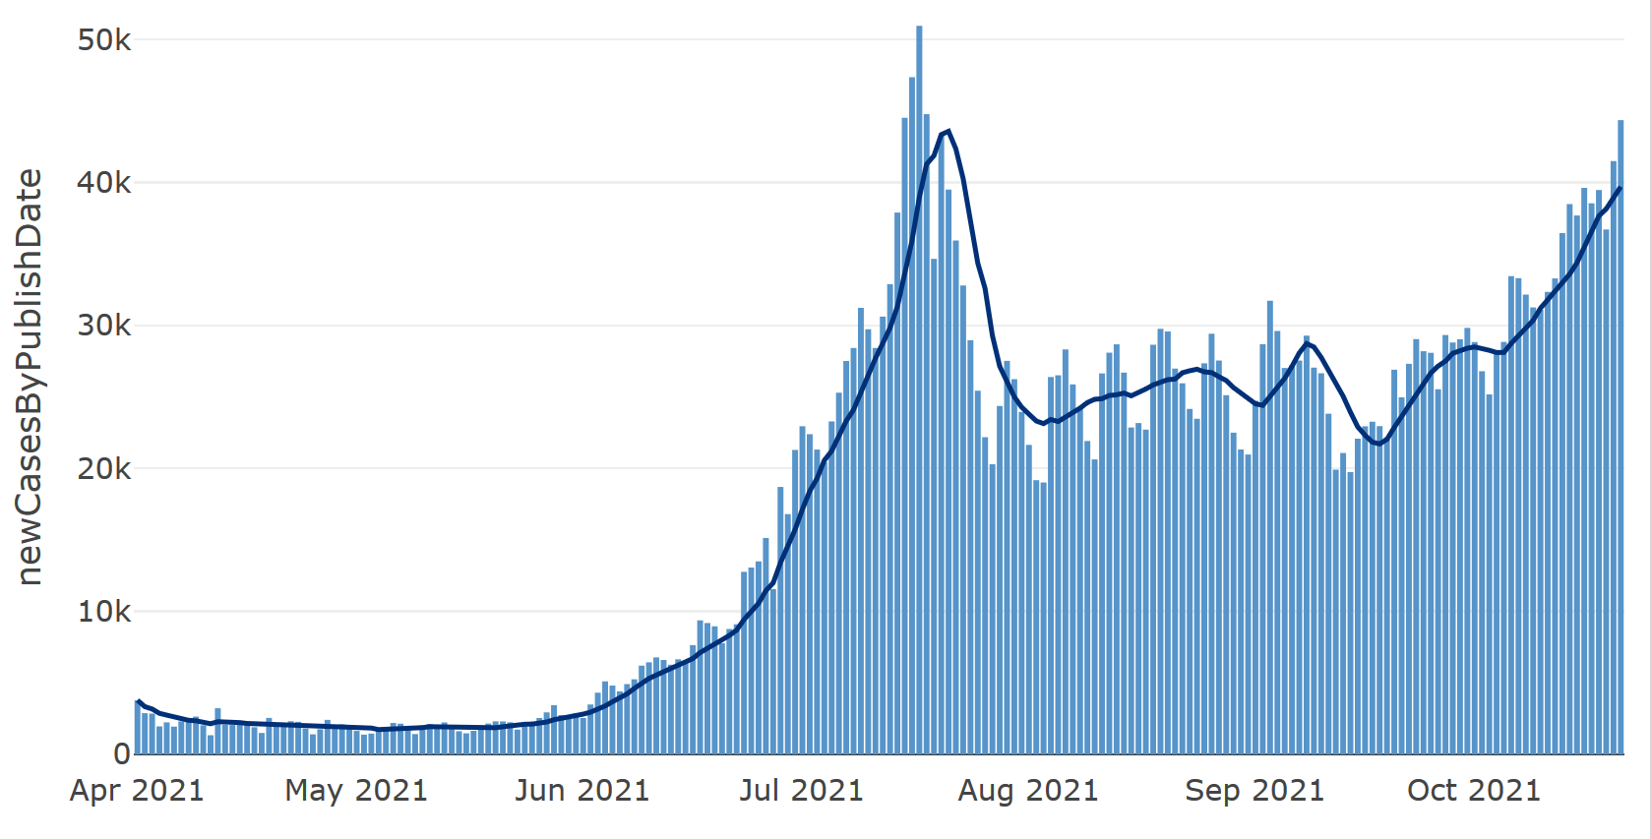
More customisation
Changing legend position
…
layout(title = "Positive cases over time", hovermode = "x unified",
legend = list(orientation = "h", xanchor = "center", x = 0.5),
xaxis = list(title = ""))
Changing hover text template
…
plot_ly(…, hovertemplate = "%{y} <b>positive</b> on %{x}")
Changing to specific colour
cases %>%
filter(areaName == "England") %>%
arrange(date) %>%
plot_ly(x = ~date) %>%
add_bars(y = ~newCasesByPublishDate, name = "Daily cases",
marker = list(color = "#5694ca")) %>%
add_lines(y = ~rollingAvg, name = "Rolling avg", line = list(color = "#003078"))

Slide 17
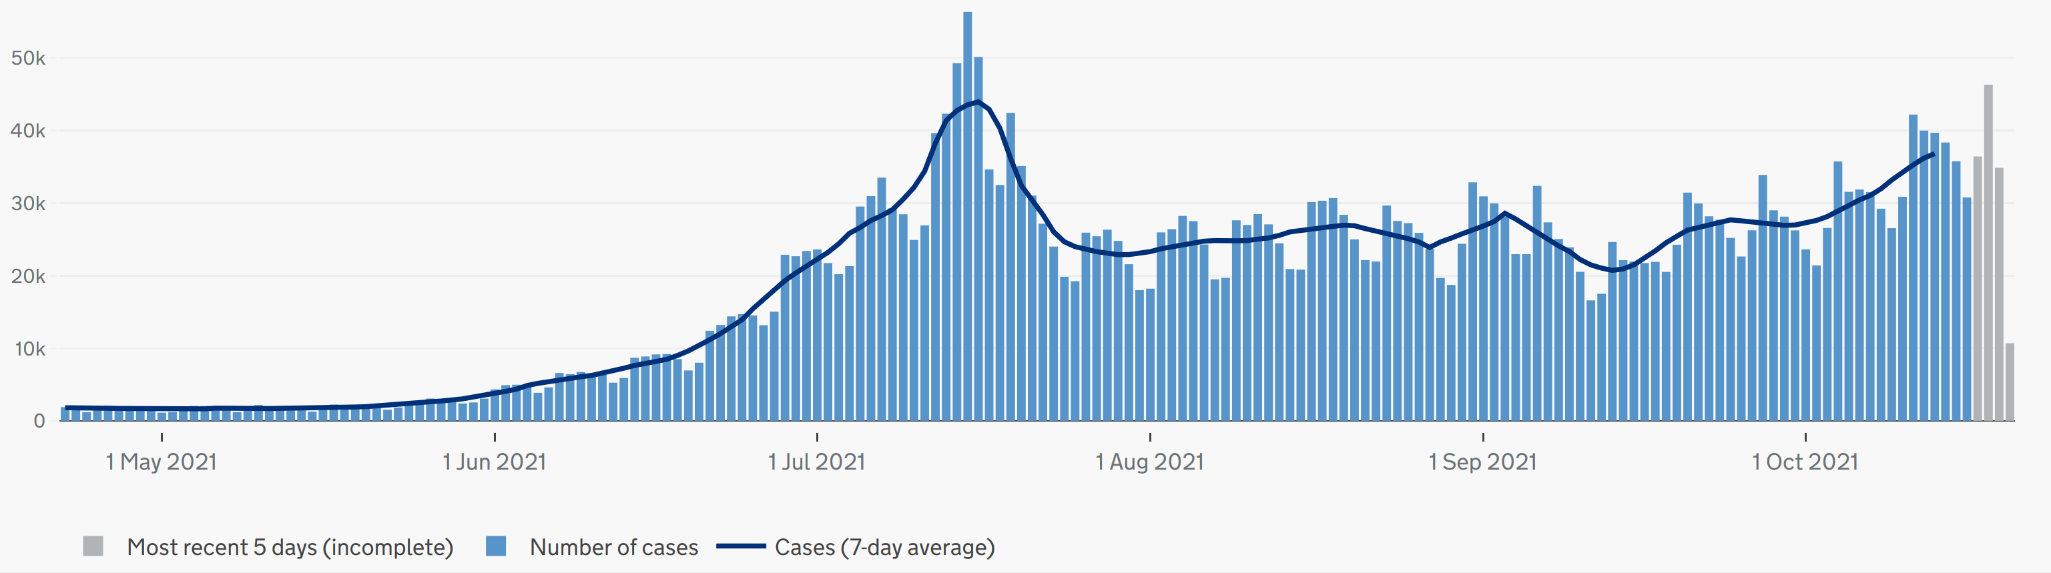
Exercise 1
Using the dataset given to you, make a bar plot showing daily COVID cases over time in England, with an additional line layer showing the rolling 7-day average over time. Name both layers - “Cases” and “ 7-day av)”. Finally, add a title.
Hints:
data %>%
plotly(x=?, y=~?, type=?, name=?) %>%
add_lines(…) %>%
layout(…)
CLICK HERE for a link to the reference plot.
Bonus:
Try changing the line colour to “#003078” (line = list(?)), changing the hovermode to “x unified”, and moving the legend to the bottom

Slide 18
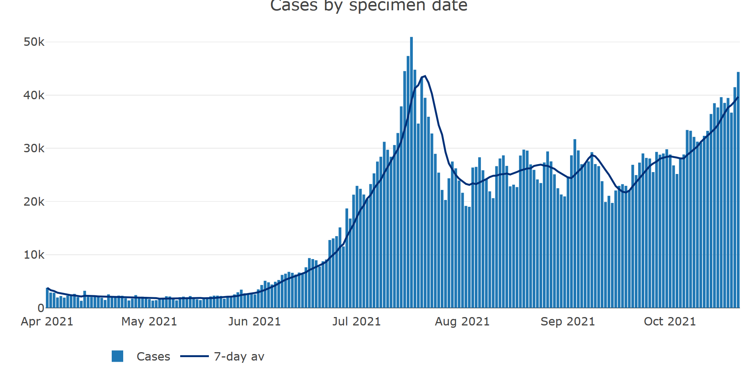
Exercise 1: answers
cases %>%
filter(areaName == "England") %>%
arrange(date) %>%
plot_ly(x = ~date, y = ~newCasesByPublishDate, type = "bar", name = "Cases") %>% # make base bar plot named “Cases”
add_lines(y = ~rollingAvg, type = "scatter", mode = "lines", # add line layer for rolling average
name = "7-day av", line = list(color = '#003078')) %>% # name it "7-day av" and change its colour
layout(title = "Cases by specimen date", # add title
hovermode = "x unified", # modify tooltip
legend = list(orientation = "h", # move legend to the bottom
xanchor = "center",
x = 0.2),
xaxis = list(title = ""), # remove x axis title
yaxis = list(title = "")) # remove y axis title

Slide 19

Break

Slide 20
ADVANCED: Adding buttons / dropdown
Uses JS functions, so R code will seem a bit more complicated, because we will be “creating” the button and menu structures. You will use lists objects a lot because it is the most complex R object that can contain multiple elements of multiple types.
"restyle": modify data or data attributes
"relayout": modify layout attributes
"update": modify data and layout attributes
More guidance and example code here:
https://plotly.com/r/custom-buttons/
https://plotly.com/r/reference/

Slide 21
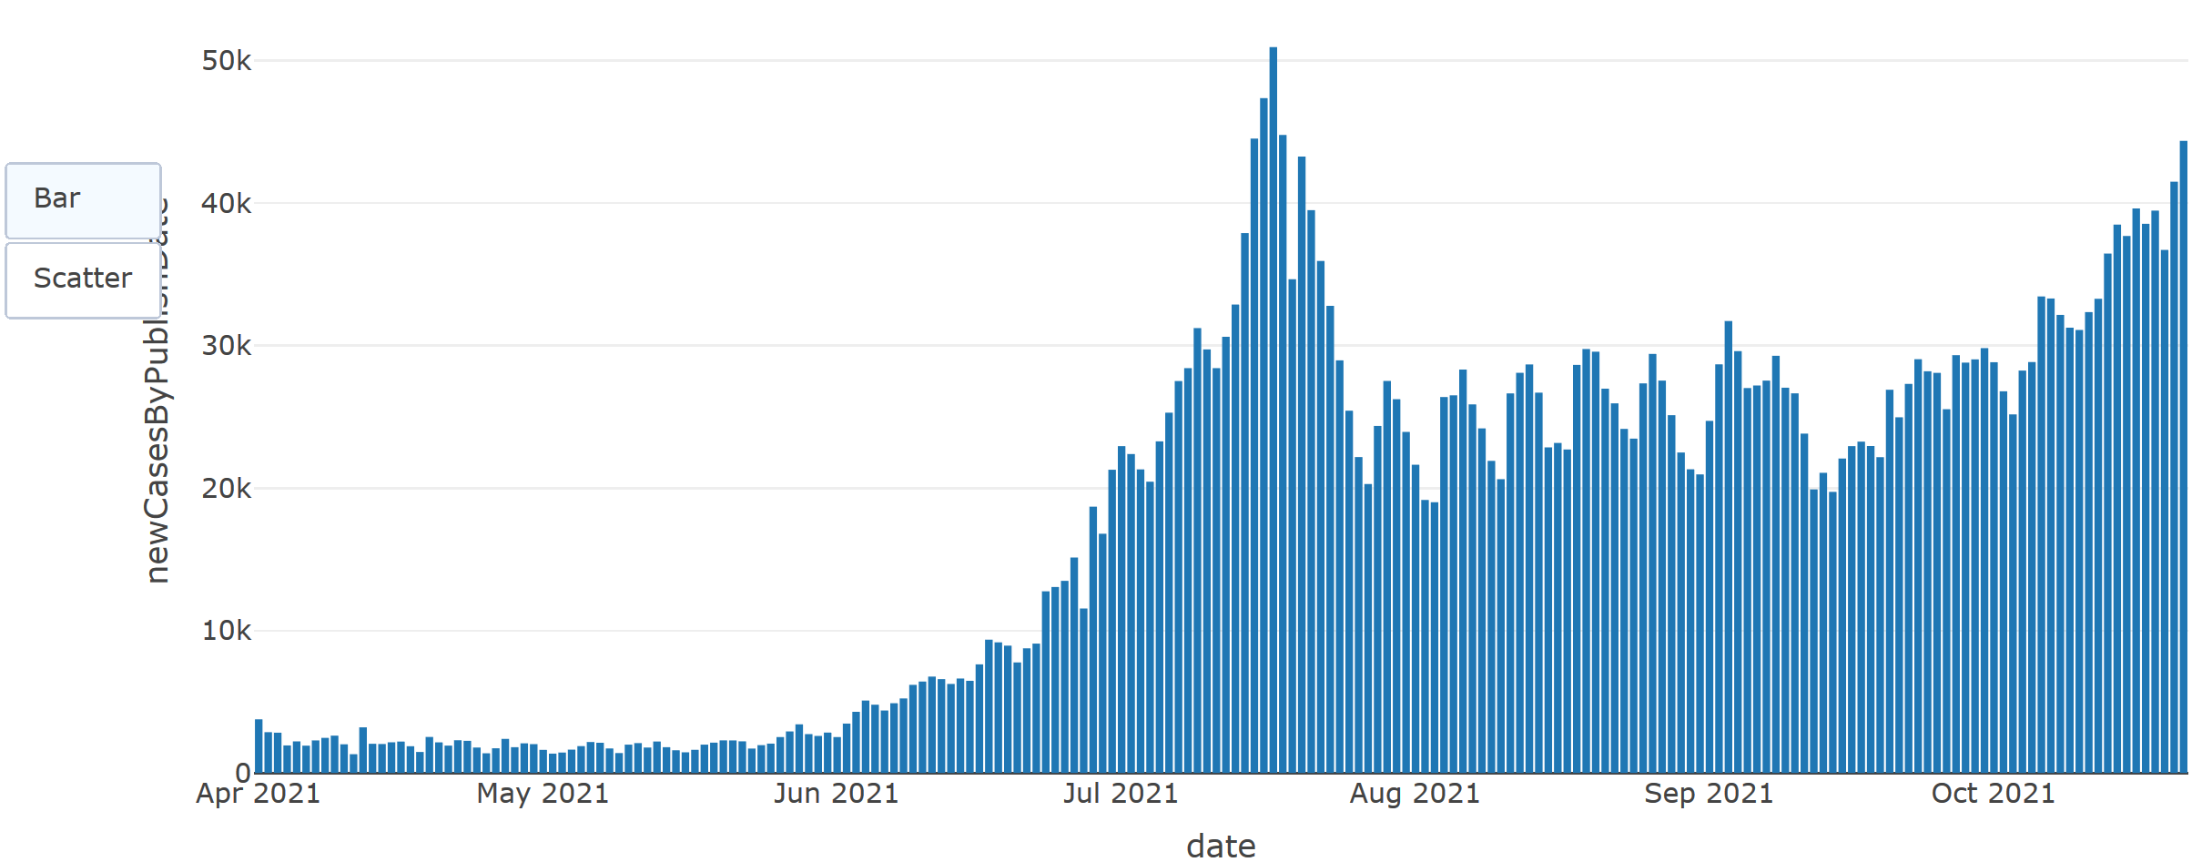
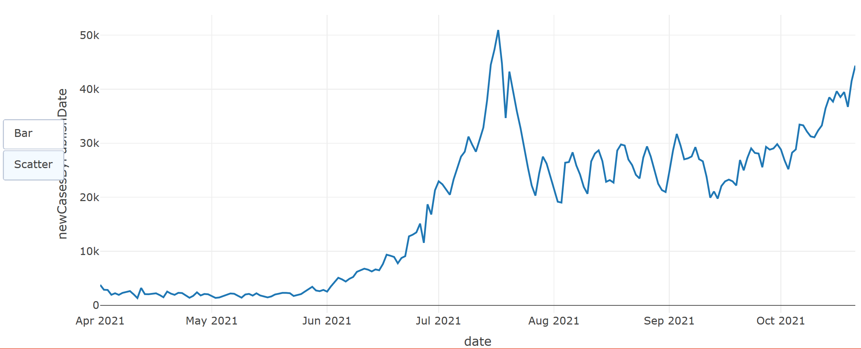
In this example we will use restyle method to modify the “type” into either “bar” or “scatter”
button_list <- list(
list(
method = "restyle",
args = list(“type", “scatter“),
label = “Scatter"),
list(
method = "restyle",
args = list(“type", " bar“),
label = “Bar" ))
cases %>%
filter(areaName == "England") %>%
arrange(date) %>%
plot_ly(x = ~date, y = ~newCasesByPublishDate, type = "bar",
name = "Cases") %>%
layout(updatemenus = list(
list(
type = "buttons",
y = 0.8,
buttons = button_list
)))

Slide 23

Echarts
Syntax is simpler!
df %>%
e_charts(x = var) %>%
e_line(var) %>%
e_bar(var) %>%
e_title() %>%
e_legend() %>%
e_tooltip() %>%
e_theme()
Etc…

Slide 24
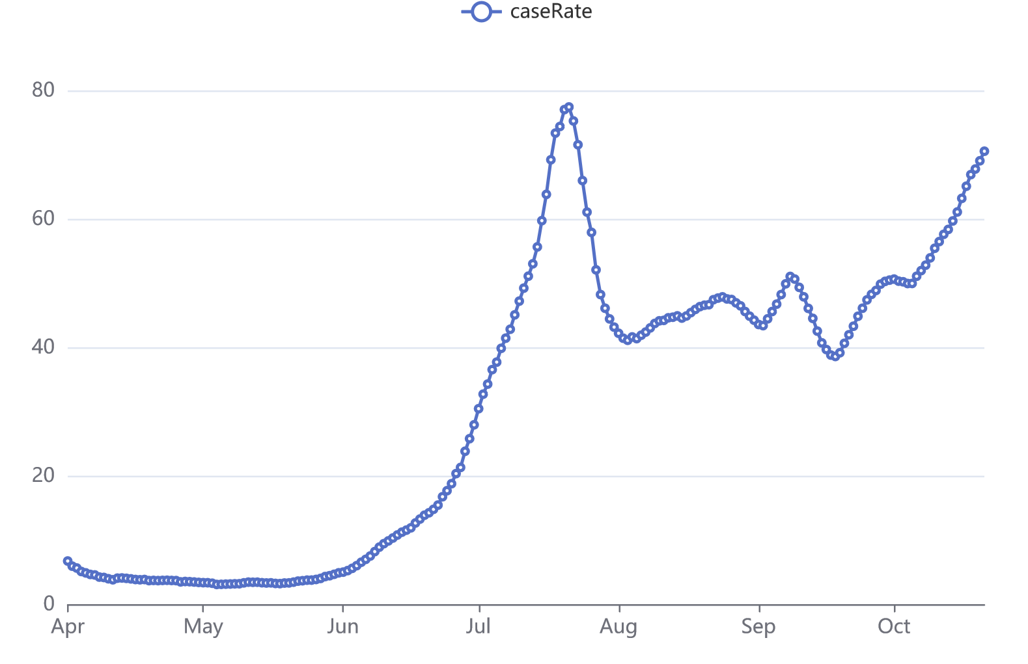
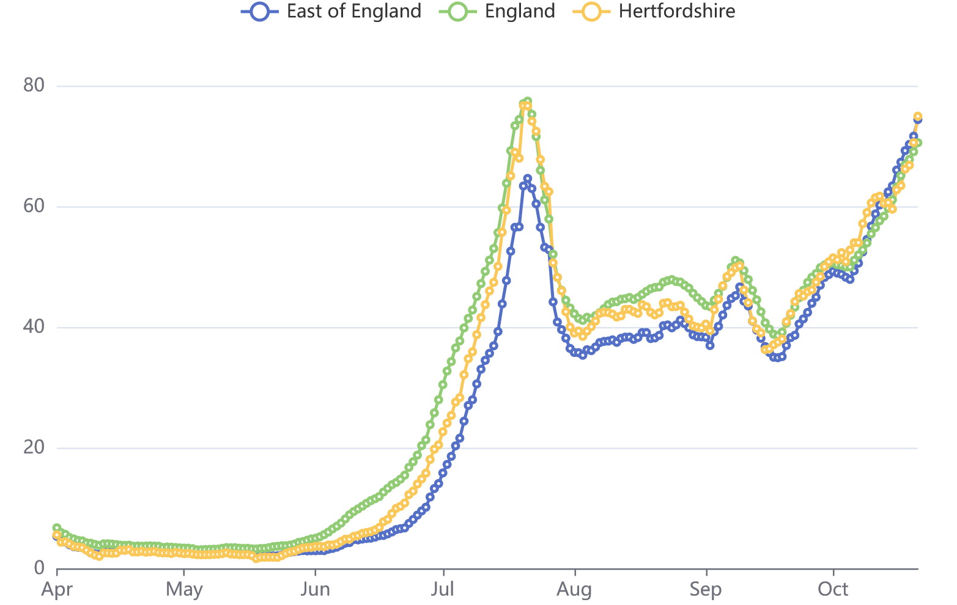
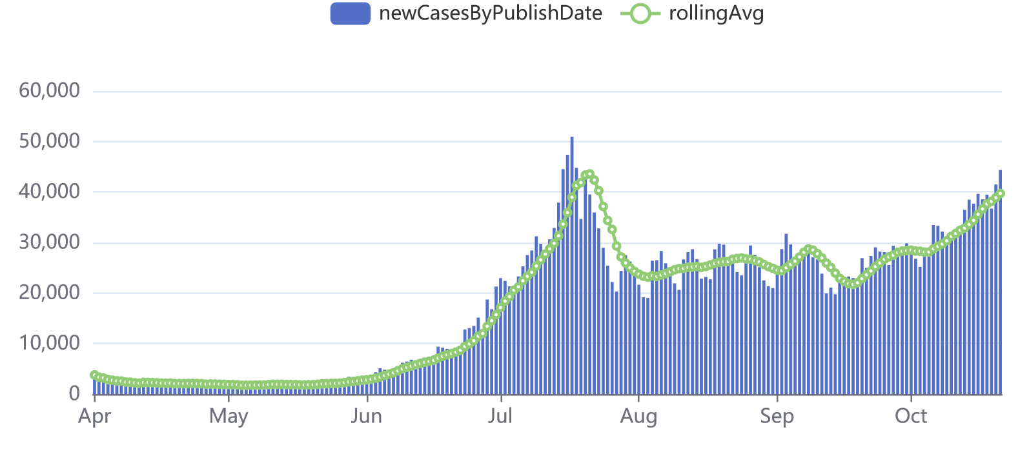
Simple line plot
cases %>%
filter(areaName == "England") %>%
e_charts(x = date) %>%
e_line(caseRate)
Grouped line plot
cases %>%
group_by(areaName) %>%
e_charts(x = date) %>%
e_line(caseRate)
Adding bar layer
cases %>%
filter(areaName == "England") %>%
e_charts(x = date) %>%
e_bar(newCasesByPublishDate) %>%
e_line(rollingAvg)

Slide 25
Echarts functions can be either a “geometric” layer (bar/scatter/line)
….or plot layout features
e_scatter()
e_bar()
e_histogram()
e_area()
e_boxplot()
e_correlations()
e_lm()
…etc.
e_legend()
e_title()
e_ x_axis()
e_y_axis()
e_tooltip()
e_error_bar()
e_theme()
..etc.

Slide 26
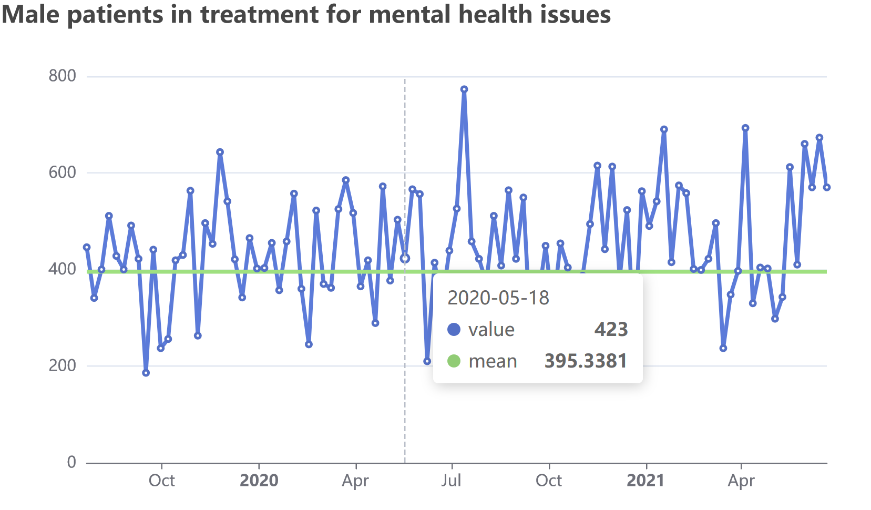
Task: Make an easy-to-read plot showing the number of Male patients in treatment for mental health over time. As a comparison, plot the mean number in treatment last year as an additional line.
mh %>%
filter(Group == "Male") %>% # Male
e_charts(Date) %>% # over time
e_line(value) %>%
e_tooltip(trigger = "axis") %>% #tooltip
e_title("Male patients in treatment for mental health issues") %>% #add title
e_legend(show = FALSE) %>% # remove legend as it's not needed
e_line(mean, symbol = "none") #add mean line with symbol = "none"

Slide 27
Tip: Referring to JS documentation
https://plotly.com/r/reference/
https://echarts.apache.org/en/option.html
Last time when we wanted to change legend positioning in plotly, we had to include a list() in the legend argument. This is the same in echarts and will happen a lot if you are working with interactive plots often.
This is due to the nature of JS code. When writing R code to “translate” into JS, we need to follow the structure of JS syntax to an extent. To access the full functionalities of these libraries we need to code our additional arguments within lists that are within lists.

Slide 28
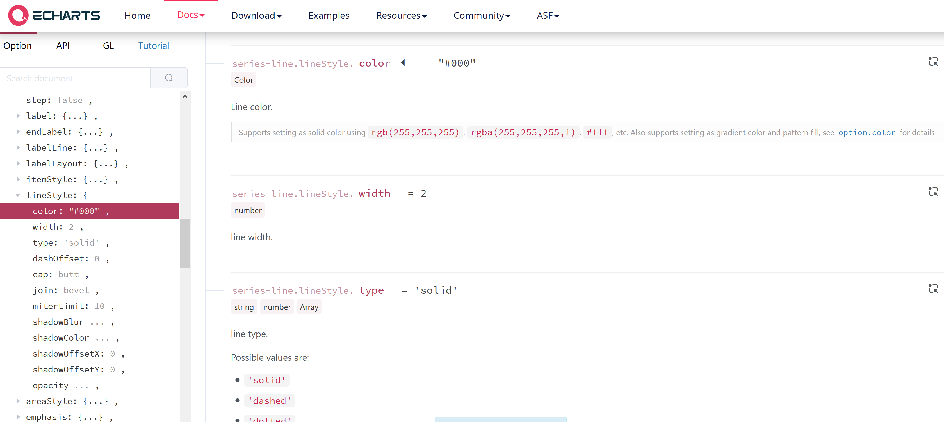
Example
There is no “direct” argument for changing the line series/layer to a specific colour. To do this we go to the original JS documentation -> find series {type: line} -> lineStyle argument -> use the color argument within the lineStyle argument

Slide 29
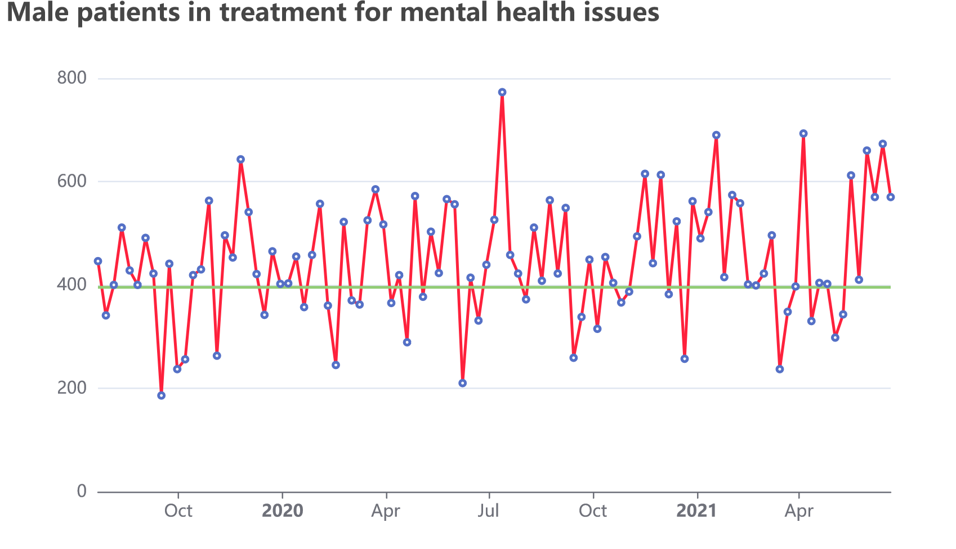
mh %>%
filter(Group == "Male") %>%
e_charts(Date) %>%
e_line(value, # within e_line (R equivalent of series: {type:line})
lineStyle = list( # we input a list of additional args WITHIN lineStyle
color = "#fe213c" # color arg within lineStyle
)
) %>% # close brackets
e_tooltip(trigger = "axis") %>%
e_title("Male patients in treatment for mental health issues") %>%
e_legend(show = FALSE) %>%
e_line(mean, symbol = "none")

Slide 30
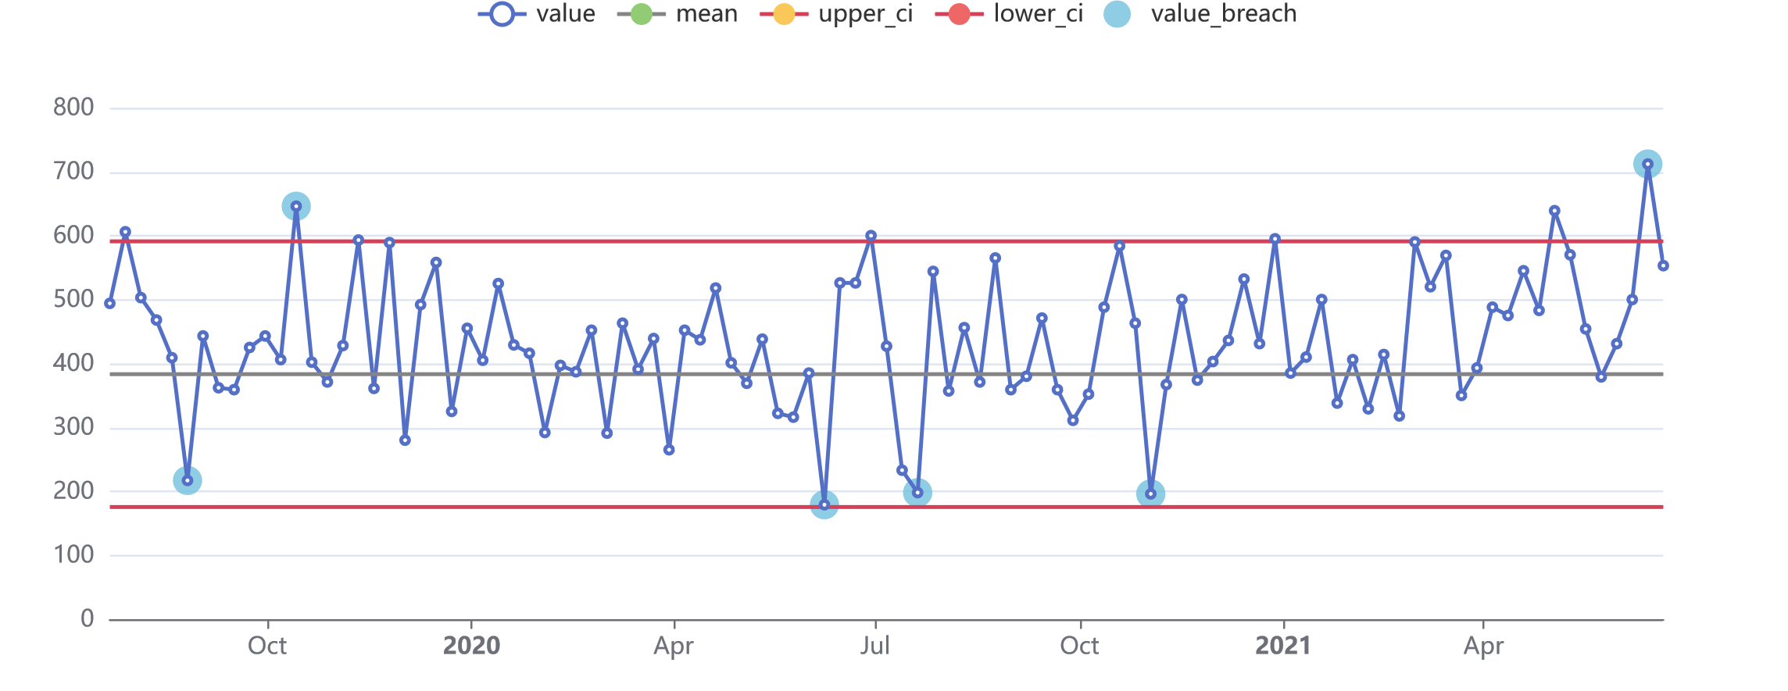
Exercise 2
Using the dataset given to you, make an SPC chart (line plot) showing count of male mental health patients in treatment over time. Add an additional line for the mean. Add two additional lines for the upper and lower confidence intervals. Set the tooltip as “axis”
Hints:
data %>%
e_line() %>%
e_line() %>%
e_line() %>%
e_line() %>%
e_tooltip()
Bonus:
Try adding a scatter layer (e_scatter) for counts that are outside the confidence intervals. These values are kept in the “value_breach” column of the dataset. To make it stand out from the line layer, add “symbolSize = 15” in the function to make it bigger.
Bonus 2 (CHALLENGE):
By referring to the documentation here, change the upper and lower CI layers to “#d53f58” and the mean layer to “#858585”.
HINT: lineStyle = list(color = ?)

Slide 31
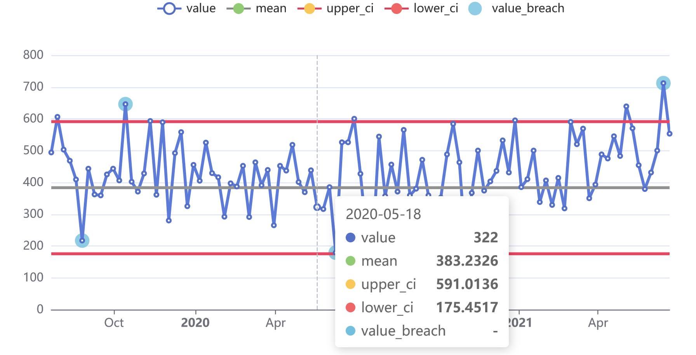
Exercise 2: answers
mh %>%
filter(Group == "Male") %>% # filter to male patients
e_charts(Date) %>% # over time
e_line(value) %>% # first line layer of values
e_line(mean, symbol = "none",
lineStyle = list(color = "#858585")) %>% # add mean line layer, change line to grey
e_line(upper_ci, symbol = "none",
lineStyle = list(color = "#d53f58")) %>% # add upper CI line layer, change line to red
e_line(lower_ci, symbol = "none",
lineStyle = list(color = "#d53f58")) %>% # add lower CI line layer, change line to red
e_scatter(value_breach, symbolSize = 15) %>% # add scatter layer and adjust symbol size to be larger
e_tooltip(trigger = "axis") # adjust tooltip to trigger on axis

Slide 32
Break

Slide 33
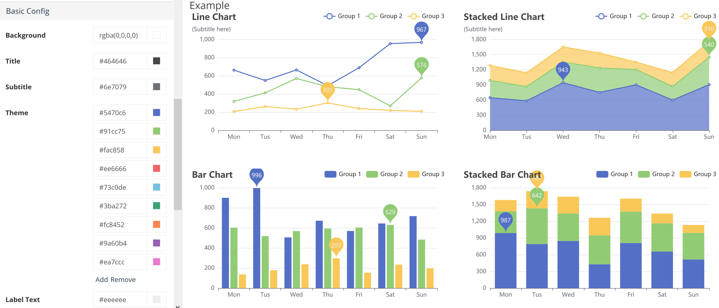
Themes and custom themes
Use the e_theme() function to change to any of the preset themes here.
To make your own custom theme with organisational colours, default line width, default symbols, etc., use the theme builder here. Then just download the .json file, upload to your project, and use e_theme_custom(“name_of_your_theme.json”)

Slide 34
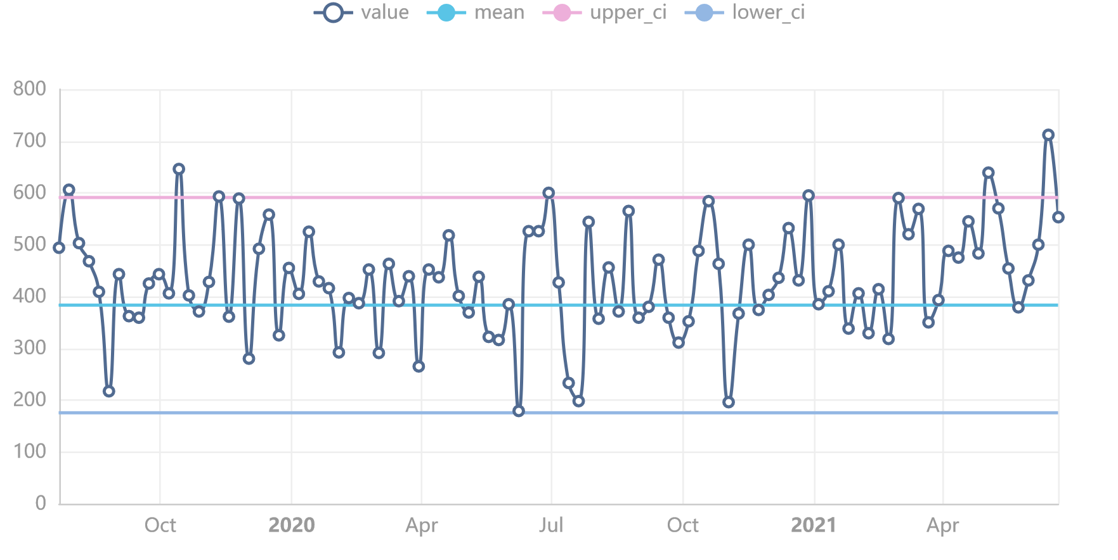
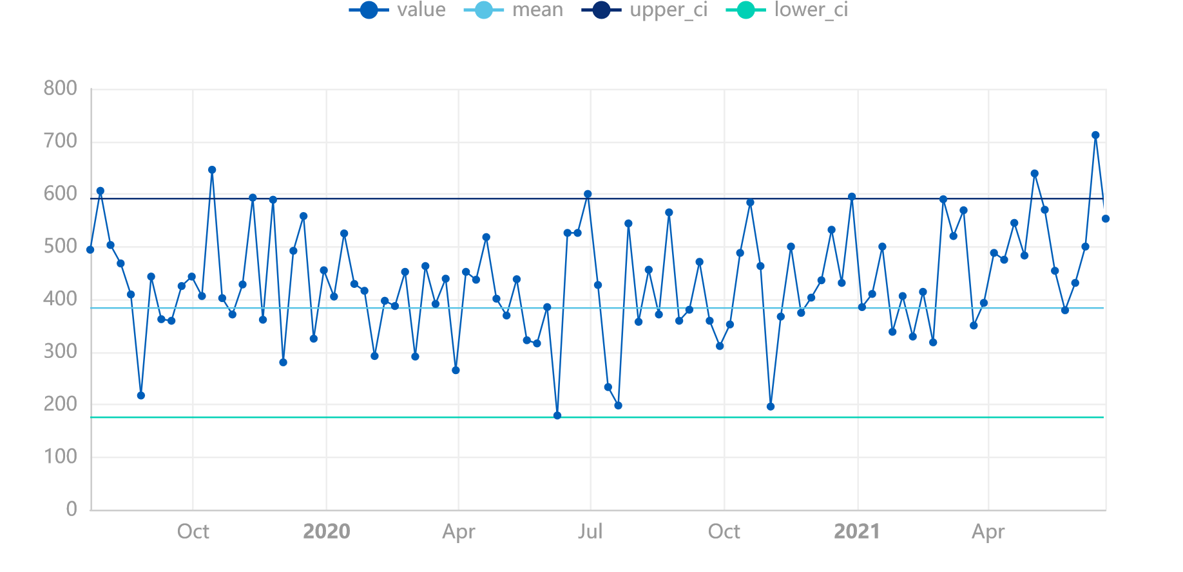
Try it out!
…
e_theme(“westeros”)
…
e_theme_custom(“custom.json”)

Slide 35
Extra: connecting graphs using e_group and e_connect_group
male <- mh %>%
filter(Group == "Male") %>%
e_charts(Date) %>%
e_line(value) %>%
e_tooltip(trigger = "axis") %>%
e_title("Male") %>%
e_line(mean, symbol = "none") %>%
e_group("mh") %>% # to connect them, they need the same group ID
e_y_axis(max = max(mh$value)) # adjusting the y axis so that it's fixed for both
female <- mh %>%
filter(Group == "Female") %>%
e_charts(Date) %>% e_line(value) %>%
e_tooltip(trigger = "axis") %>%
e_title("Female") %>%
e_line(mean, symbol = "none") %>%
e_group("mh") %>% # same group ID
e_y_axis(max = max(mh$value)) %>%
e_connect_group("mh") # connect this plot with any plots with the same group ID
e_arrange(male, female, cols = 2)

Slide 36
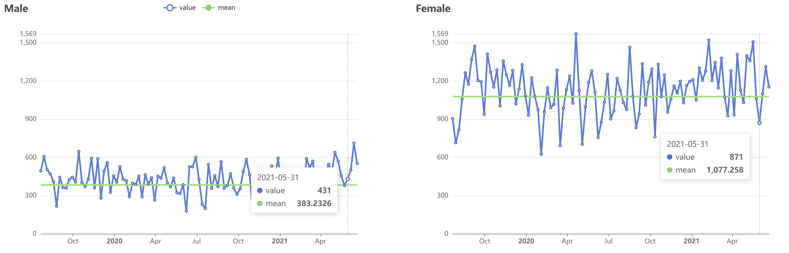

Slide 37
Echarts or Plotly?
Plotly pros
Is more popular. This means if you have an issue you are more likely to find another user who has experienced it and solved it.
Generally has more functionality
More filtering options (buttons/dropdowns). Also works with crosstalk!
Certain structures are better supported, like error bars.
Echarts pros
Simple syntax, easier to learn and read
Easy connection between subplots
Easier to customise theme: https://echarts4r.john-coene.com/articles/themes.html

Slide 38
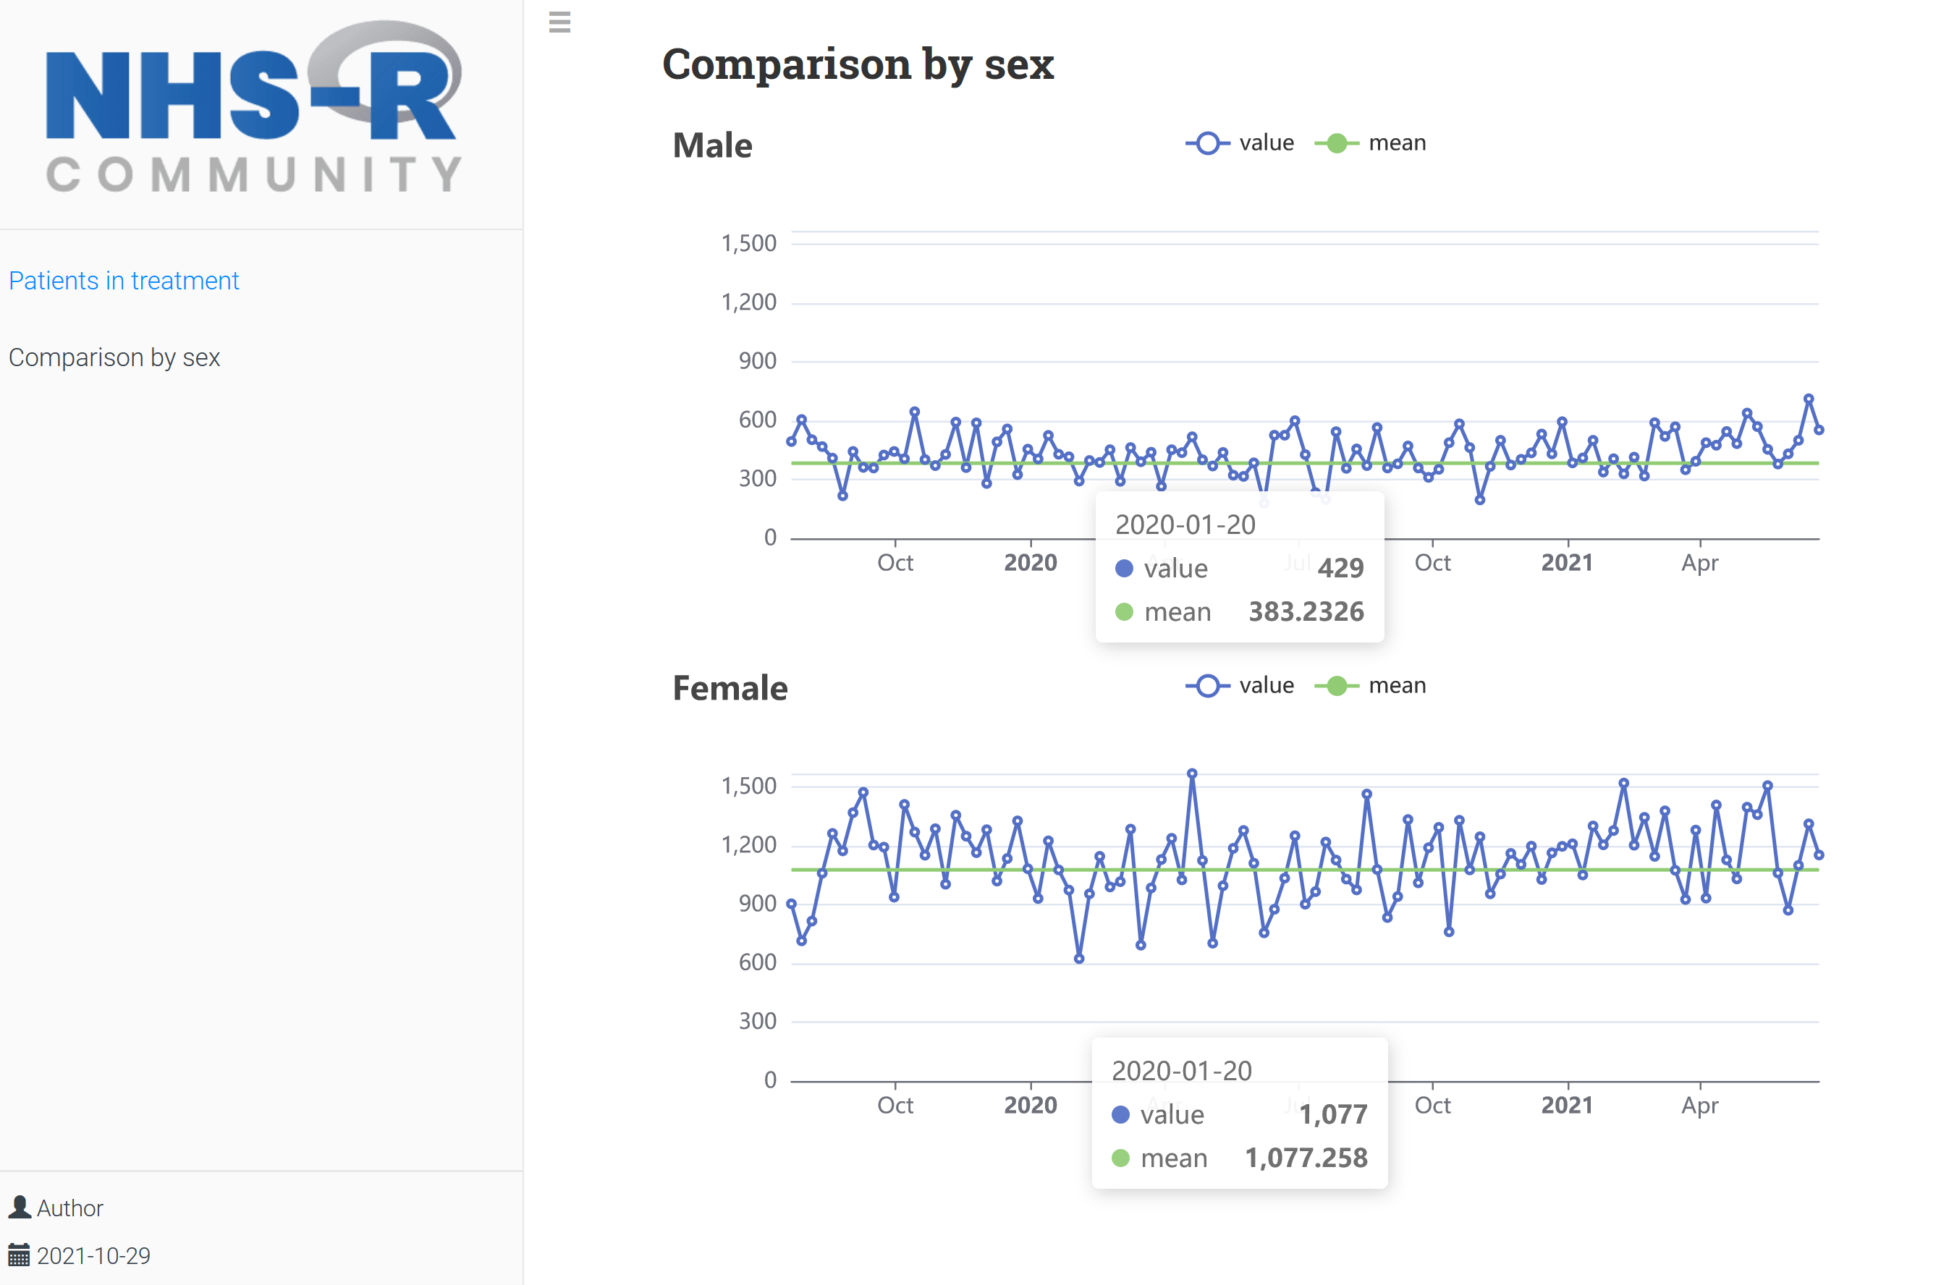
Exercise 3
Open exercise_3.Rmd. You will be coding in the last chunk that’s below “Comparison by sex”
Make the SPC chart you made for Exercise 2 for male patients and then for female patients. Give them both the same group ID using e_group and connect one of them using e_connect_group.
Connect the two plots using e_arrange.
Knit the Rmarkdown report!

Slide 39
Other packages
leaflet – powerful interactive mapping package
crosstalk – allows linkage between widgets (including plotly and leaflet) and user filters
visNetwork - interactive network graphs with lots of user interaction
networkD3 – another package for interactive network graphs
dygraphs
highcharts
billboarder
shiny – if you are building a dashboard / tool with maximum user interactivity, building a shiny app is the way to go.

Slide 40
Resources
Plotly :
R help page - https://plotly.com/r/
Reference page - https://plotly.com/r/reference/
Book on “Interactive web-based data visualization with R, plotly, and shiny”
Echarts:
R package website - https://echarts4r.john-coene.com/
Reference page - https://echarts.apache.org/en/option.html
https://www.r-graph-gallery.com/

